Slide 1
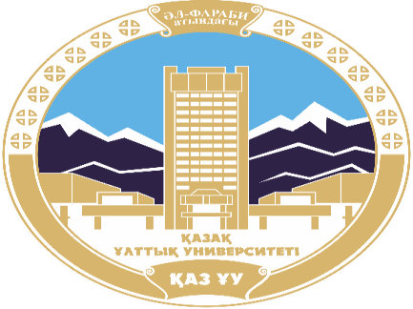
AL-FARABI KAZAKH NATIONAL UNIVERSITY
Department of political science and political technologies
Working practices of international organizations
Abzhapparova A.A.
Senior lecturer

Slide 2
Working practices of international organizations
Lecture 1
Introduction to the course

Slide 3
Lecture plan:
  The world political process. Concept and main trends. Globalization and regionalization.
  Political map of the world.
  Foreign policy activities of the state. It’s forms. Geopolitics.

Slide 4
The world political process
The world political process is the combined activity of subjects of international relations in the exercise of their functions. Its subjects are:
peoples and ethnic groups
civilizations
States
(foreign policy of the state)
International organizations
non-governmental associations
social movements
TNCs
Regional organizations
political and social leaders.
Their combined activity forms the structure of the global political process..

Slide 5
The main trends in the global political process:
increasing ambitions of the main centers of power of world politics;
the growing influence of regional processes on the development of the political situation in the world;
the integration of political life, the involvement of new states in the orbit of world politics; the integration of political life, the involvement of new states in the orbit of world politics;
the formation of global problems (these include preserving peace, minimizing military danger, preserving the environment, combating epidemic diseases, crime and terrorism).
the main priorities of modern world politics are war and peace, universal security, environmental protection, overcoming backwardness and poverty. the main priorities of modern world politics are war and peace, universal security, environmental protection, overcoming backwardness and poverty.
national security of each state: internal stability, reliable defense, sovereignty, independence, territorial integrity.national security of each state: internal stability, reliable defense, sovereignty, independence, territorial integrity.

Slide 6
Globalization and regionalization.
Globalization is a process of global economic, political and cultural integration and unification.
Regionalization is the process of the end of the XX-beginning of the XXI century, in which the influence of the region on the internal affairs of the state is strengthened.
Economic:
the formation of a planetary market, the growth of cross-border movements of goods.
Political:
the formation of interstate organizations
Social:
the ability to communicate between geographically remote groups of people
Spiritual:
rapid development of the Internet, erosion of cultural diversity.
Law:
Standardization and unification of legal systems. The phenomenon of international law.

Slide 7
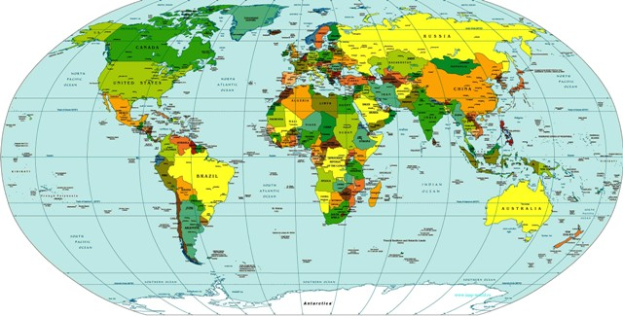
  Political map of the world.
193 recognized states (+ about 20 unrecognized)
World RegionsWorld Regions
International Organizations: Global and Regional

Slide 8
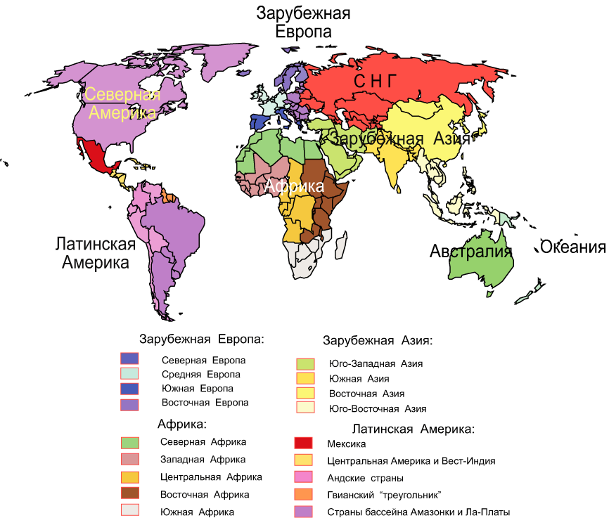
WORLD REGIONS

Slide 9
Foreign policy activity of the state. Its forms.
Geopolitics - a consciously conducted or spontaneously forming state policy to the extent that it is associated with geographical and territorial factors (from the Greek “geo” - the land and what is connected with it, and “politicos” - what is connected with the policy: state, citizenship)
The basis of geopolitics is the national interest of a particular state!

Slide 10
National interest
In politics, generally expressed or group interests are always expressed, and in international politics, predominantly national interests.
National interest is the recognition and reflection in the activities of leaders of the fundamental needs of the nation state. Needs are expressed in ensuring national security and conditions for self-preservation and development of society.
The concept of "national interest" was developed by the American political scientist G. Morgenthau.

Slide 11
Foreign policy
National interest finds concrete expression in setting the goals and objectives of the state’s foreign policy — the position of the state that it occupies or intends to occupy in the world community, the general course of the state in interacting with other subjects of international relations.
  Foreign policy is determined by:
World economical situation
strategic situations
impact of individual states
environmental impact, the state of raw materials and natural resources

Slide 12
Materials used in the lecture :
Barkin J.S. International Organization: Theories and Institutions. Third Edition. — Palgrave Macmillan, 2023. — 205 p.
Weiss Thomas G. (ed.). International Organization and Global Governance. Third Edition. — Routledge, 2023. — 844 p.
Acharya Amitav, Buzan Barry. The Making of Global International Relations: Origins and Evolution of IR at Its Centenary. Padstow Cornwal: Cambridge University Press, 2019. — 397 p.
Baldacchino Godfrey, Wivel Anders (eds.) Handbook on the Politics of Small States. Edward Elgar Pub., 2020. — 448 p
Dalio R. Principles for Dealing with the Changing World Order: Why Nations Succeed and Fail. New York, NY: Avid Reader Press, 2021. — 576 p

